Slide 1
Welcome to the Presentation on the
Validation Clause in the ESI Amendment Bill, 2009

Slide 2
"If people don't know what you're doing, they don't know what you're doing wrong."
-One of the advices of the Principal Secretary Sir Humphrey
to his junior in ‘Yes, Minister’, explaining the strength of bureaucracy.

Slide 3
Health services to Unorganised Sector
03.07.2008
The Employees' State Insurance (Amendment) Ordinance, 2008 was promulgated on 03.07.2008 to enable the Employees' State Insurance Corporation to participate in the Rashtriya Swasthya Bima Yojana Scheme for providing health services to the unorganised sector workers.
The Rashtriya Swasthya Bima Yojana Scheme had
already become operational with effect from1-4-2008.

Slide 4
It was “considered essential and urgent to enable the Employees‘ State Insurance Corporation to participate in the Scheme with immediate effect. By providing health services to the unorganised sector workers under the Rashtriya Swasthya BimaYojana Scheme, both unorganised sector workers and the Employees' State Insurance Corporation would benefit by the Employees' State Insurance Corporation making available its vast network of hospitals for providing medical care on user charges, wherever the same were underutilised.
In view of the urgency as pointed out above, the Employees' State Insurance (Amendment) Ordinance, 2008 was promulgated on the 3rd July, 2008. To replace the said Ordinance, the Employees' State Insurance (Amendment) Bill, 2008 was introduced in Parliament on 21-10-2008 and the same was referred to the Department-related Parliamentary Standing Committee on Labour for examination and report. The Committee presented its report on the 19th December, 2008.
The Committee agreed in principle the provisions of the said Bill. However, it made certain recommendations for improvement in the proposed Scheme.
However, due to the dissolution of the Fourteenth Lok Sabha, the said Bill lapsed”.
-Excerpts from the Statement of Objects and Reasons

Slide 5
The need
When the Ordinance was in force during the period from July, 2008 to the date of its getting lapsed, some actions might have been taken by the ESIC or some actions which were required to be taken might not have been taken.
These actions and inactions required parliamentary approval, because what was done or not done was because of an ordinance which was, then, allowed to lapse.

Slide 6
As per the law making process, such cases would be placed before the Parliament for regularisation of whatever had been done or not done during the period of ordinance.
A specific clause would be added in such cases, for such regularisation, and that is called Validation Clause.
When Parliament approves the Bill and the Bill becomes law, that Validation Clause would be shown to the CAG and other authorities as proof of the authorised nature of the actions and expenditure, if any.

Slide 7
In this case, the Bill was prepared accordingly.
Later, another Bill was also under submission for making multifarious amendments to the Act regarding appointment of consultants, specialists, medical colleges, etc.,
The Ministry of Law which examined the Bills advised preparation of a single comprehensive Bill because, introducing two separate Bills for amendment at the same time for a single Act would not be legally sound.
Accordingly a combined Bill was prepared and sent to the Advice Department of the Ministry of Law.

Slide 8
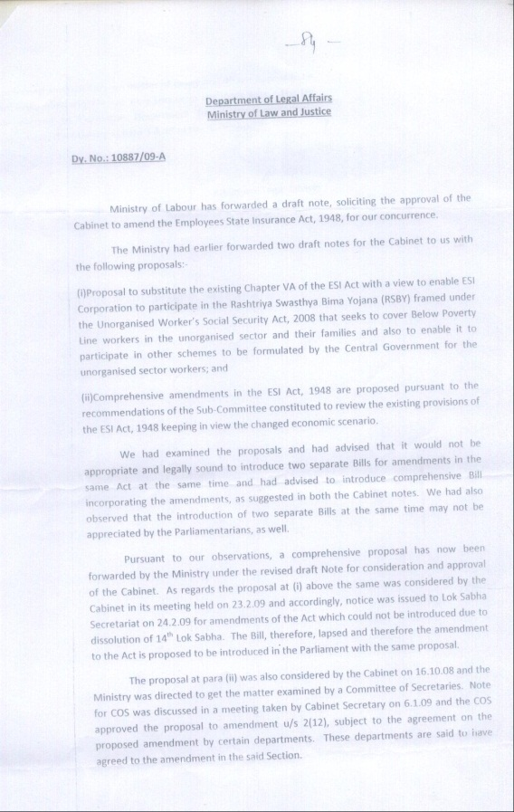
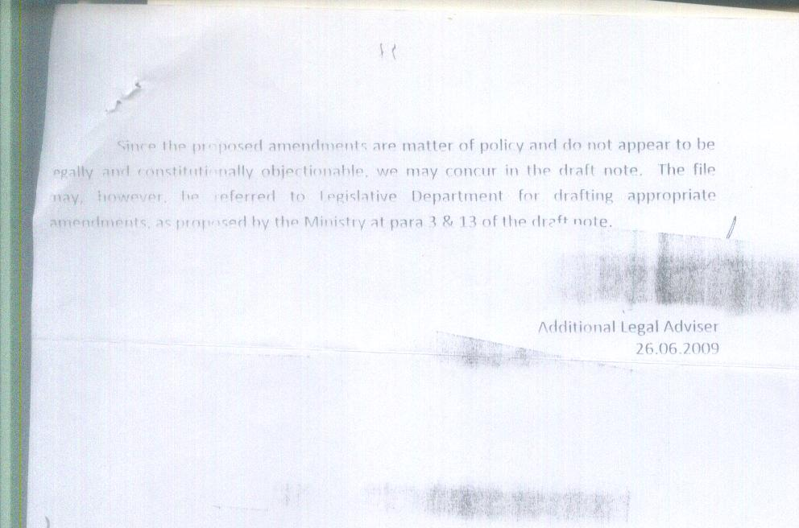
Note of the Ministry of Law
Dy. No. 10887/09-A
Page 1
Page 2

Slide 9
Result
When both Bills were combined, the Validation Clause was included in such a place that it enabled regularisation of not only the actions or inactions with reference to the RSBY matters but also the actions and inactions with reference to the appointment of consultants, specialists, medical colleges, etc.,
These actions regarding appointment of consultants, specialists, etc., had been taken during the years 2008 and 2009, when there was no legal sanction for it.
The Act permitted such actions, later, only from 1.6.2010, after the amendment in May 2010.

Slide 10
As the place where the Validation Clause had been inserted in the combined Bill raised his eyebrows of the readers, Mr. A. Veerappan requested the Ministry of Law, in his application dated 25.9.2009, to provide the following information:
“I. In the context, the present Clause 17, if becomes part of the Act, would result in regularizing the actions and inactions of the officers in the Hqrs. of the ESI Corporation with reference to the issues dealt with in the Clause 15 pertaining to medical colleges and in Clause 5 pertaining to appointment of consultants, and various other aspects also”.

Slide 11
“II. If the intention had been to regularize the actions and inactions in the fields other than RSBY also, especially those dealt with in the Clauses 15 and 5, the Ministry of Law would have, definitely, examined already, in its file, all the actions and inactions of the officers of the ESI Corporation in those fields (other than RSBY) which required such retrospective regularization”.
“Please, therefore, intimate whether the Clause 17 is intended to cover and protect the issues pertaining to the RSBY only or to regularize the irregularities, if any, with reference to the issues dealt with in Clause 15 and Clause 5 also.
If so, kindly supply a copy of the notefile containing the details of such past actions and inactions in the fields (other than RSBY) which were intended, by the Ministry of Law, to be regularized retrospectively through this Clause”.

Slide 12
Ministry of Law did not come forward with proper reply, in spite of the fact that the question had arisen only because of their suggestion to combine two proposals.
The Ministry of Law were not ready to take a re-look into the issue and to examine the effect of the place of insertion of that Validation Clause, even after such specific questions were raised, under the RTI Act.

Slide 13
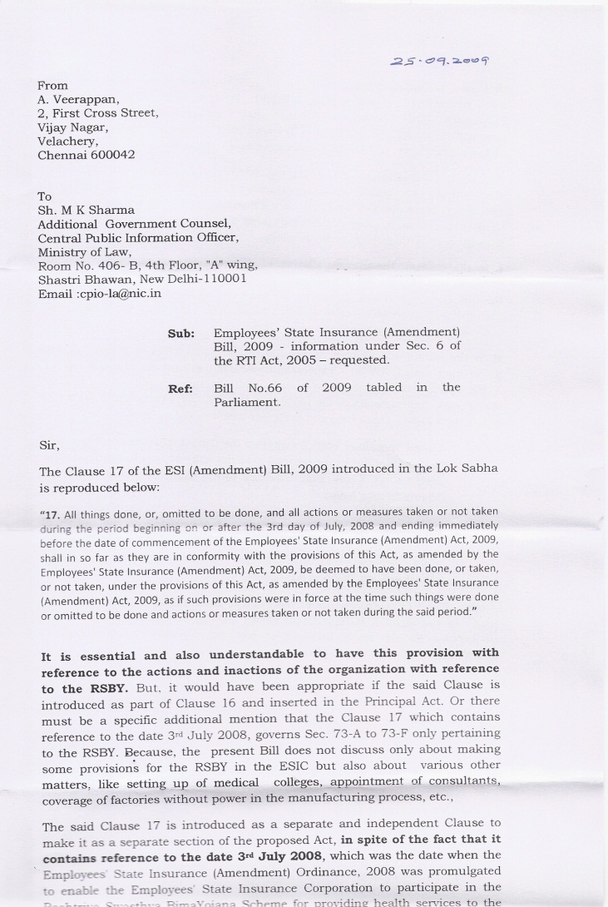
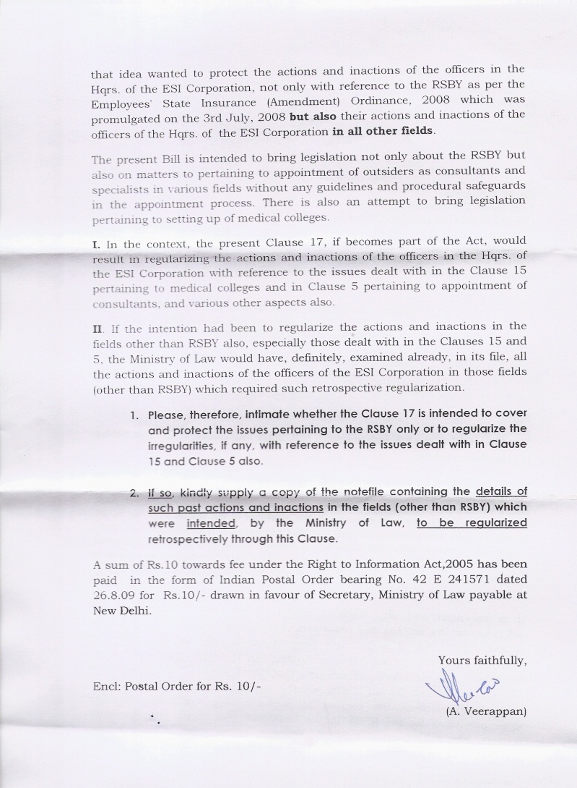
Application to the Ministry of Law & Justice

Slide 14
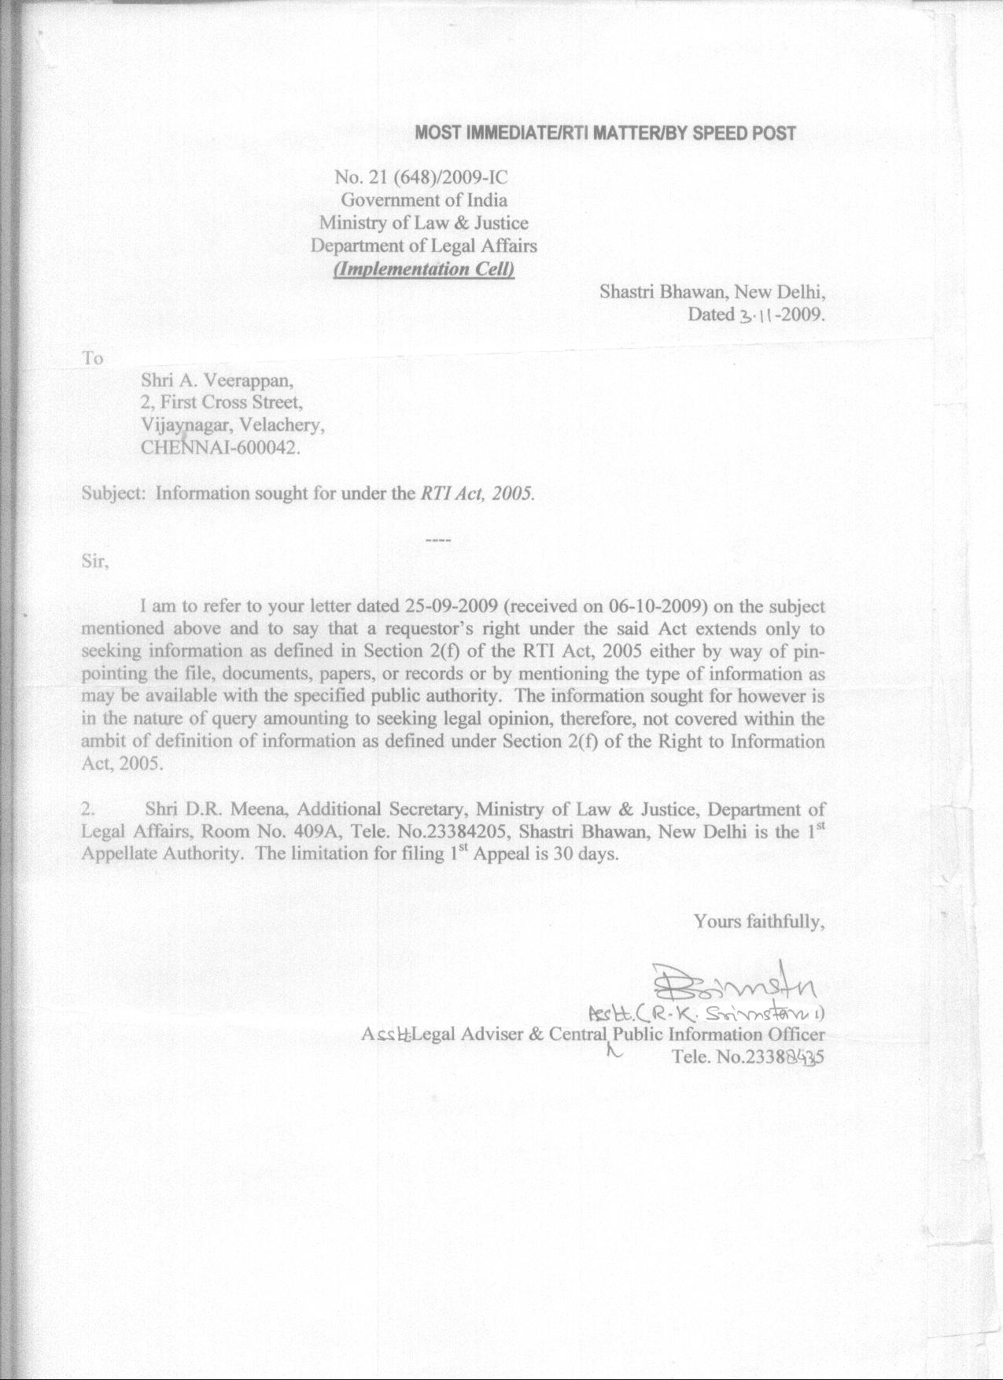
Reply of the Ministry of Law & Justice in
Letter No. 21 (648) 2009 – IC dated 3.11.2009

Slide 15
Readers may please think over
whether the combination of the two Bills resulted in the unintended regularisation of actions in spheres other than RSBY also or not.
whether the Ministry of Law was right in placing the Validation clause in the manner in which it had done it, while combining the two Bills.
whether the Ministry of Law was right in ignoring the implications of such placement of the Validation Clause, even when its attention was drawn, by Mr. A. Veerappan in the year 2009 itself, specifically to the lapse on its part.
and whether there was any other provision through which the action taken, before June 2010, in respect of appointment of consultants, specialists and setting up of medical colleges had been regularised.

Slide 16
Readers are welcome to offer their views!
N.B: The First Appellate Authority of the Ministry of Law
was appealed to against the reply of the CPIO.
What he did will be dealt with in a separate ‘Post’ later.
That ‘Post’ will show the readers important aspects of RTI Act provisions.

Slide 17
Legal Advisor
During this period Mr. K. N. Chaturvedi was working as the Legal Advisor/ Retainer of the ESI Corporation.
He was the former Secretary, Ministry of Law & Justice.
This is only a statement of fact.

Slide 18
That’s all folks!

